Slide 1


Twitter Mood Map
Project Members：
Yang Cao
Shengyang Su
Bin Zhang
Bill Chen
Fan Yang
Yuwei Lin

Slide 2

Overview
Backgound
Grab the Data
Sentiment Analysis
Map the mood
Visualization
Result Analysis

Slide 3
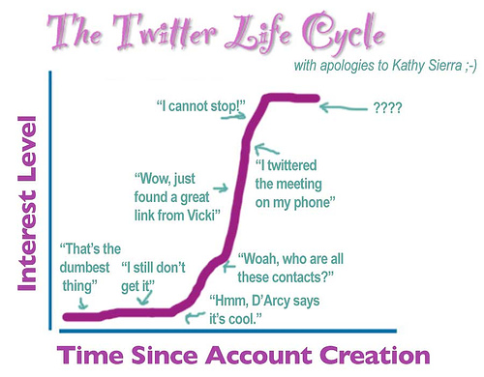

Background

Slide 4

What is Twitter?
A continually expanding global database that can be accessed by anyone, anywhere

Slide 5
Background
Twitter Statistic | Data
Active Twitter users | 289 million
New Twitter users signing up everyday | 135 thousand
Average Tweets per day | 58 million
Twitter search engine queries per day | 2.1 billion
Users who don’t Tweet but view Tweets | 40%

Slide 6
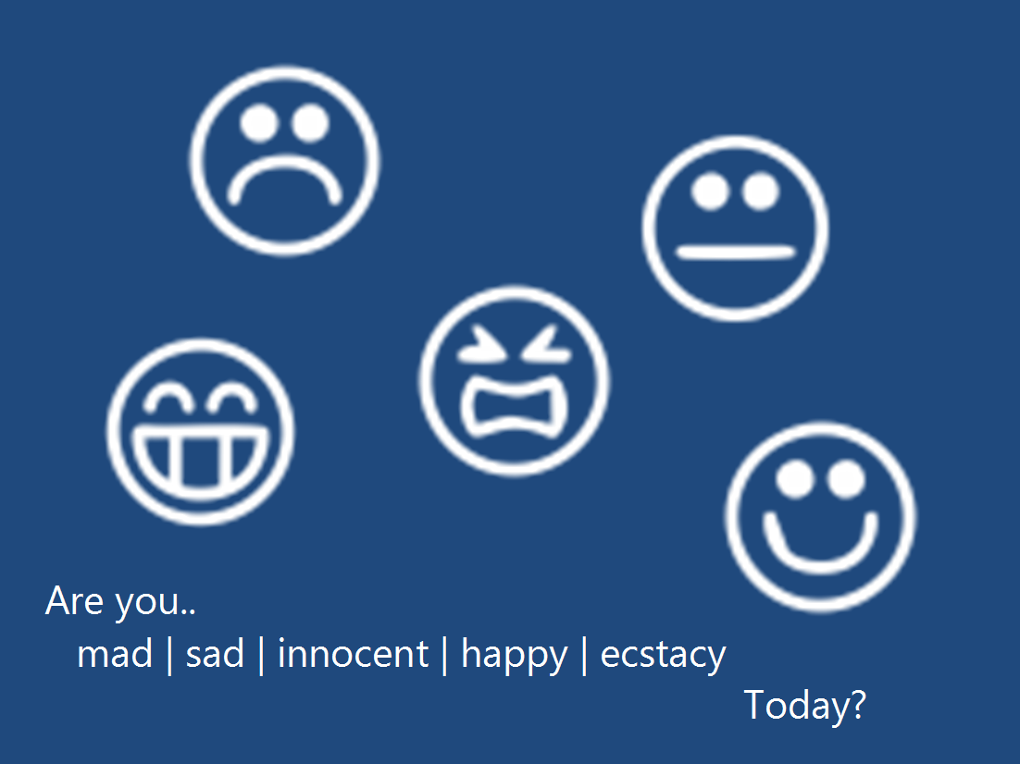
Background

Slide 7

Background
Facing Problems
what twitter users thinking?
how they feel now?
Are they in good mood or not?
How people's mood vary in different places

Slide 8
Overview
Backgound
Grab the Data
Sentiment Analysis
Map the mood
Visualization
Result Analysis

Slide 9

Grab the Data
We used twitter real-time streaming data with "Tweepy" and twitter streaming API
We retrieved around 12 hours' tweets using Python
We Collected 70000 items!
We reconstructed them

Slide 10
Overview
Backgound
Grab the Data
Sentiment Analysis
Map the mood
Visualization
Result Analysis

Slide 11
Sentiment Classifier
We tried to implement Naïve Bayes like classifier to analyze the sentiment preference of tweets
We leveraged the research result posted on the following website
http://alexdavies.net/twitter-sentiment-analysis/
The accuracy of the classifier is about 60%

Slide 12
Classifier Implementation
We want to find the words with emotional preferences, and give them weights
We can learn the emotional preferences by analyzing the annotated tweets provided by Twitter
We give each word happy weight and sad weight according to the analyzing of the annotated corpus

Slide 13
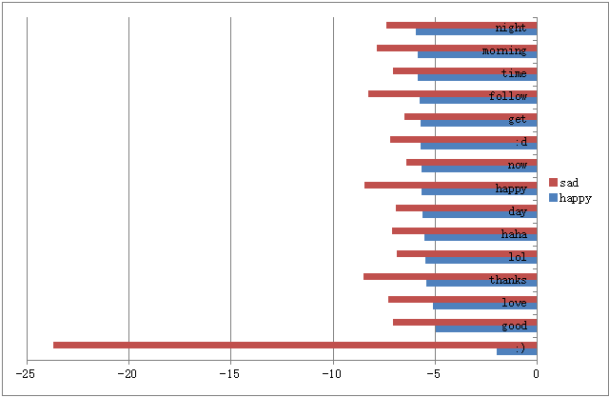
Classifier Implementation
The following table shows the happy and sad weights of some words in our table

Slide 14
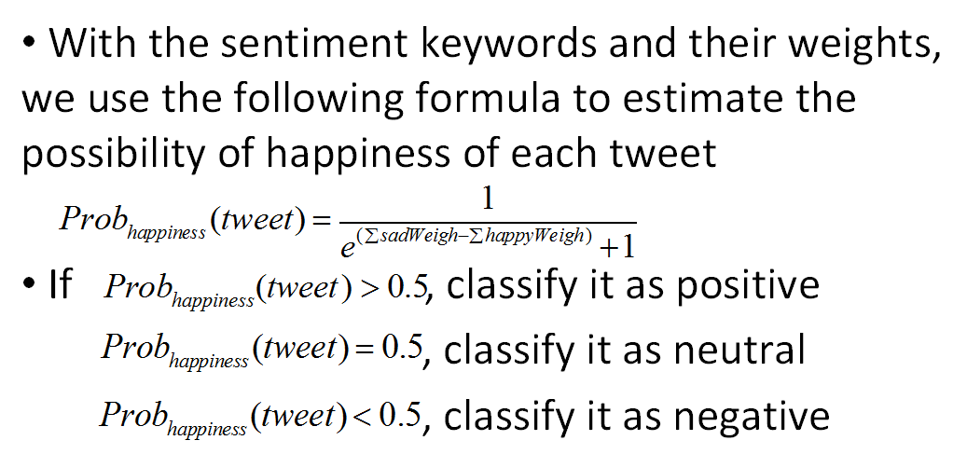
Classifier Implementation

Slide 15

The Analysis of Tweets
Challenges:
  Lots of typos
  lots of grammar errors
  Lots of informal usages
  e.g. okkkkk; awesomeeeee
  Lots of symbol expressions
  e.g. :) stands for smile; <3 stands for heart
  Therefore, some parsing and tagging techniques don’t work well here

Slide 16
Overview
Backgound
Grab the Data
Sentiment Analysis
Map the mood
Visualization
Result Analysis

Slide 17
Map the Mood
We used Google API-GeoCoder to locate the twitters via Python
We transferred 70000 tweets' longitude and latitude info to the actual address format

Slide 18
Overview
Backgound
Grab the Data
Sentiment Analysis
Map the mood
Visualization
Result Analysis

Slide 19
Visualization
1. Change the type of the table to the formal csv type.
2. The seven attributes are timestamp, userid, tweet_message, longitude, latitude, mood, and address.
3. Remove the rows with garbled text or missing data.
4. Input the table to http://cartodb.com/

Slide 20
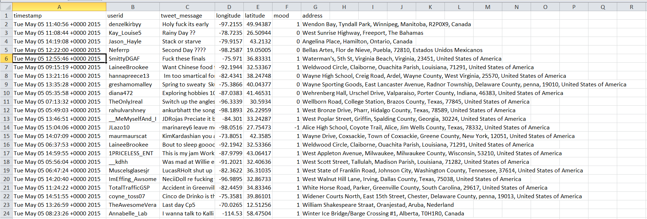
Visualization

Slide 21
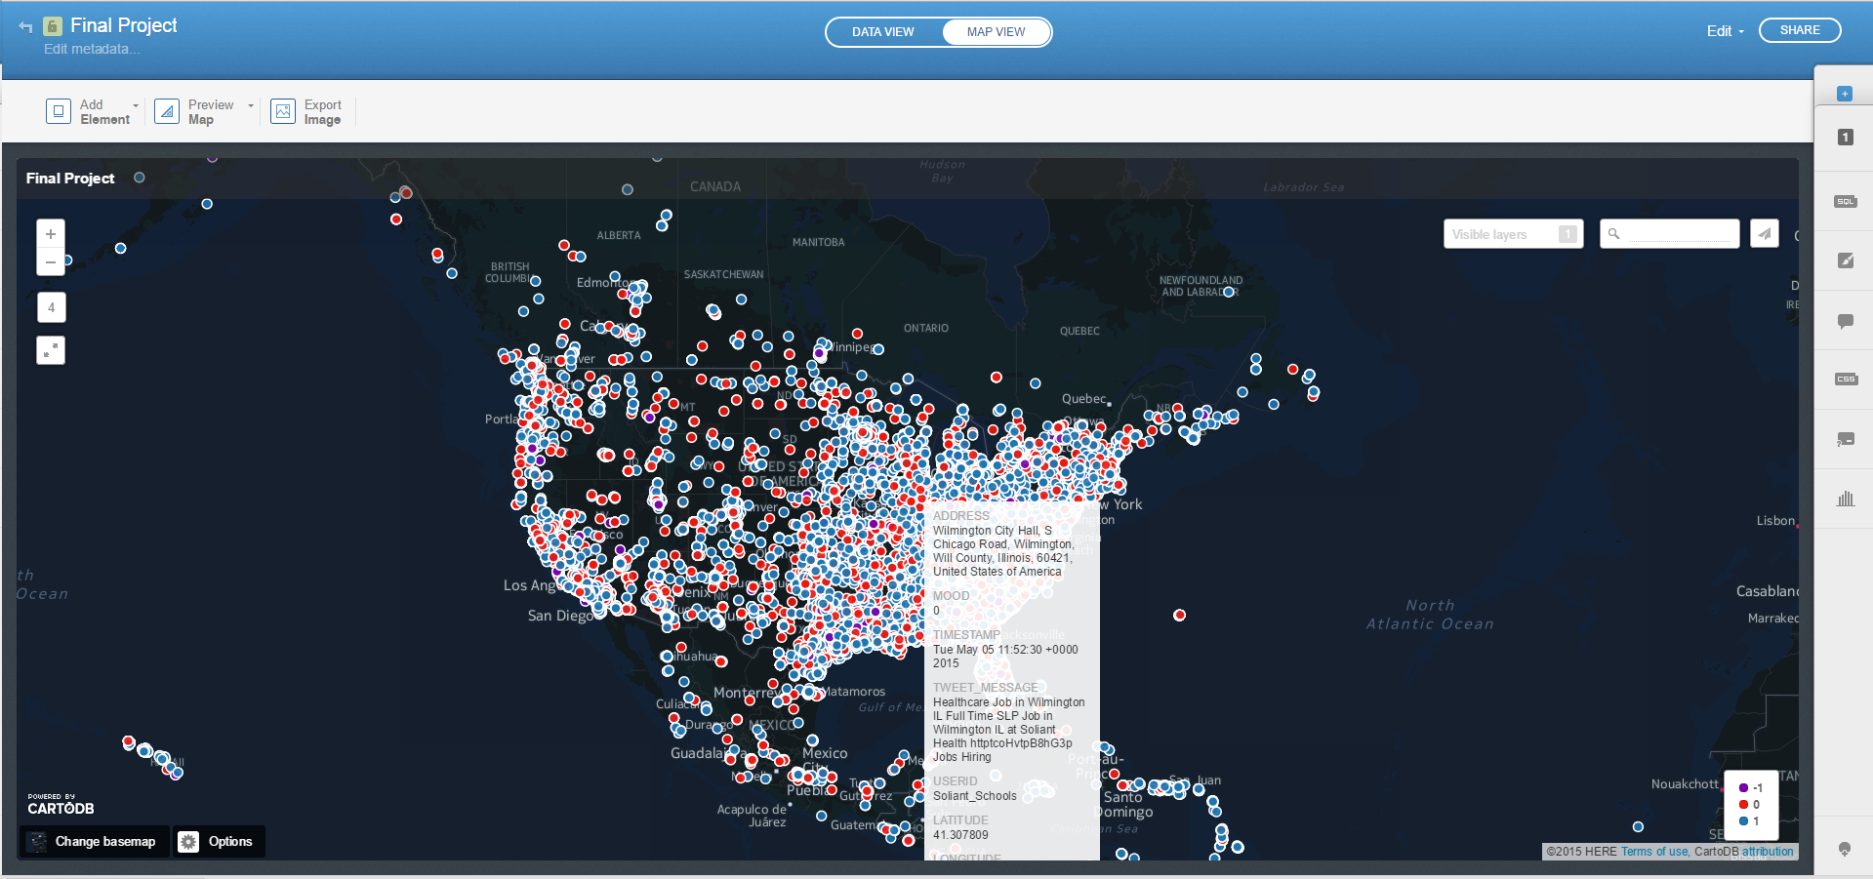
Mood Map

Slide 22
Overview
Backgound
Grab the Data
Sentiment Analysis
Map the mood
Visualization
Result Analysis

Slide 23

Result Analysis
We analyzed the results using Spark-Scala
We visualized the statistic result using R

Slide 24
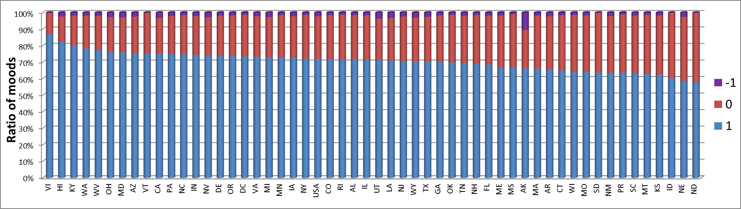


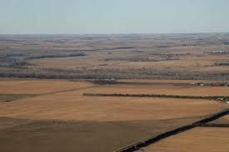

Result Analysis
US Virgin Islands
Hawaii
Nebraska
North Dakota

Slide 25

Result Analysis
After that, we also made a clustering via Spark-Scala-KMeans(K=3 and 5)
We visualized the statistic result and found our results make sense!

Slide 26
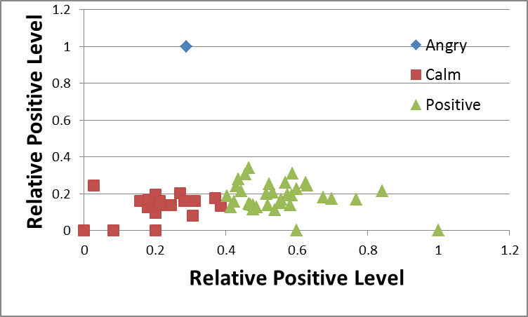
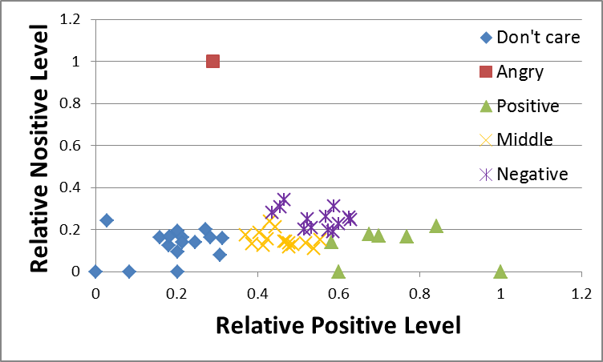
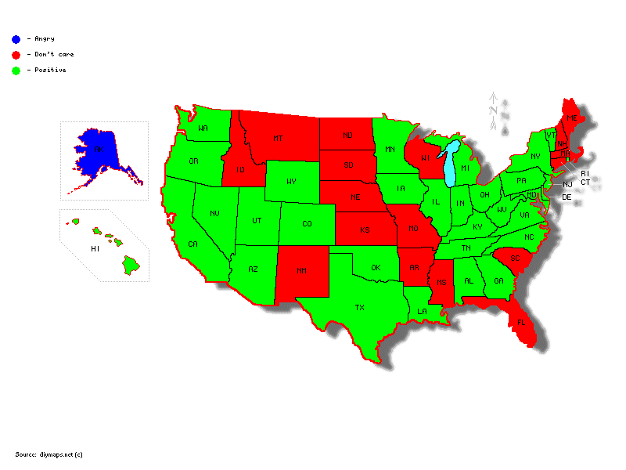
Result Analysis

Slide 27
Our techniques
Grab the data
Re-construct the data
Sentiment analysis
Locate the tweets
Visualize the map
Analyze the results
@SocialMediaQUB
Pyhon, NLP,Tweety
Spark-Scala,Kmeans
GeoCoder, R

Slide 28
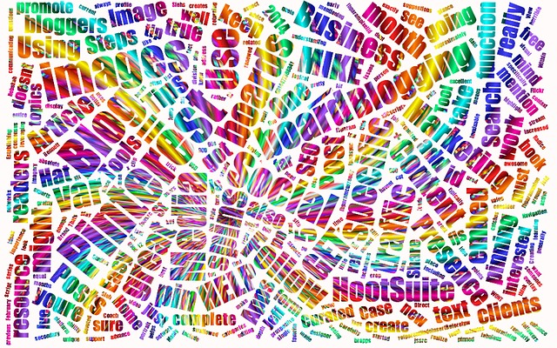
“With 225 million users issuing half a billion tweets per day, Twitter represents the richest dataset to hit academia….well, maybe ever—a virtual Petri dish of real-time data, attractive to scholars of all disciplines, for studies of all sorts.”

Slide 29
Questions ?
Thanks !

